Slide 1
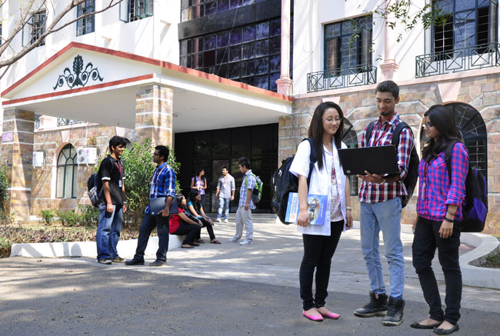

B.Tech Computer Science and Engineering – Vth Semester
Theory of Computation
Department of Computer Science and Engineering

Slide 2
Decidability and Undecidability
Recursive Languages
A language L is said to be recursive if there exists an TM for the language L which accepts strings only from that language and rejects all other strings.
The TM halts every time giving an answer whether the string is accepted or not.
Recursively Enumerable Languages
A language L is said to be recursive if there exists an TM for the language L which accepts strings from that language and eventually halts.
But may or may not halt for all the input strings that belongs to the languages.

Slide 3
What
A

Slide 4
What
A

Slide 5
What
A

Slide 6
What
A

Slide 7
What
A

Slide 8
Thank You .. Have a Great Day

